Slide 1
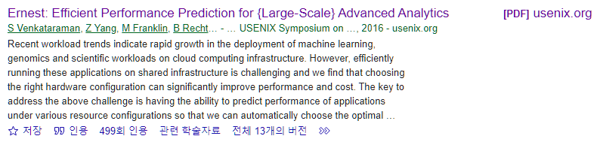
Ernest: Efficient Performance Prediction for Large-Scale Advanced Analytics
Venkataraman, Shivaram, et al.
13th USENIX Symposium on Networked Systems Design and Implementation (NSDI 16). 2016.
22.11.22.
Cloud Computing
Sohee Kim
Notes:
Venkataraman, Shivaram, et al. "Ernest: Efficient Performance Prediction for {Large-Scale} Advanced Analytics." 13th USENIX Symposium on Networked Systems Design and Implementation (NSDI 16). 2016.
https://www.usenix.org/system/files/conference/nsdi16/nsdi16-paper-venkataraman.pdf
https://www.youtube.com/watch?v=dTfkBkkakOM&t=39s
https://www.slideshare.net/SparkSummit/ernest-efficient-performance-prediction-for-advanced-analytics-on-apache-spark-spark-summit-east-talk-by-shivaram-venkataraman?from_action=save

Slide 2
1. Introduction
Venkataraman, Shivaram, et al. "Ernest: Efficient Performance Prediction for {Large-Scale} Advanced Analytics." 13th USENIX Symposium on Networked Systems Design and Implementation (NSDI 16). 2016.
Workload trends : advanced analytics (machine learning, genomics, scientific)
Challenge : predicting the most efficient configuration for large advanced analytics applications in a heterogeneous multi-tenant environments
User’s goal : Minimizing the running time given a budget / Meeting a deadline while minimizing the cost
Performance model
data
Job
Ernest (A performance prediction framework for large scale analytics)
A new approach that can accurately predict the performance of a given analytics job
The main idea is to run a set of instances of the entire job on samples of the input, and use the data from these training runs to create a performance model.
Black box jobs → but works well
Has low overhead (takes much less time and resources to run the training jobs than running the job itself)
Optimal experiment design : statistical technique to select the most useful data points for training
How Ernest can detect when a model isn’t appropriate and how small extensions can be used to model complex workloads
Execution experiments on Amazon EC2 → accurate for a variety of algorithms, input sizes, and cluster sizes.
Notes:
대역폭 Bandwith : 일정 시간 동안 해당 버스를 통해 전송될 수 있는 데이터의 양
워크로드 Workload : 주어진 기간에 시스템에 의해 실행되어야 할 직업의 할당량. 애플리케이션을 지원하는 스토리지 객체. the amount of work an individual has to do
Recent workload trends indicate rapid growth in the deployment of machine learning, genomics and scientific workloads on cloud computing infrastructure
In this paper, they address the challenge of choosing the configuration to run large advanced analytics applications in heterogeneous multi-tenant environments.
The choice of configuration depends on the user’s goals which typically includes either minimizing the running time given a budget or meeting a deadline while minimizing the cost.
The key to address this challenge is developing a performance prediction framework that can accurately predict the running time on a specified hardware configuration, given a job and its input.
So they propose a new approach that can accurately predict the performance of a given analytics job named Ernest.
The main idea is to run a set of instances of the entire job on samples of the input, and use the data from these training runs to create a performance model.
Despite the fact that this is a black-box approach. It works surprisingly well in practice.
This approach has low overhead, as in general it takes much less time and resources to run the training jobs than running the job itself.
The cost and utility of training data points collected is important for low-overhead prediction and we address this problem using optimal experiment design, a statistical technique that allows us to select the most useful data points for training.
They show how Ernest can detect when a model isn’t appropriate and how small extensions can be used to model complex workloads. •
Using execution experiments on Amazon EC2, they show that Ernest is accurate for a variety of algorithms, input sizes, and cluster sizes.
The reason this approach works so well is because many advanced analytics workloads have a simple structure and the dependence between their running times and the input sizes or number of nodes is in general characterized by a relatively small number of smooth functions.

Slide 3

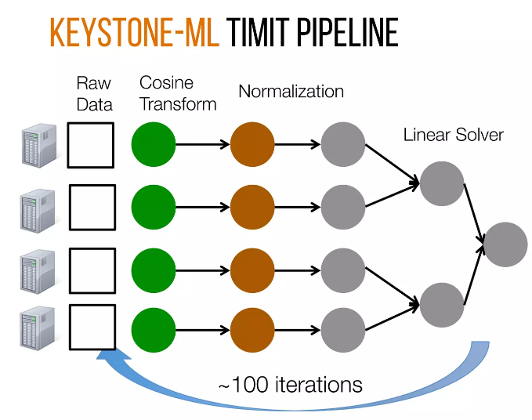
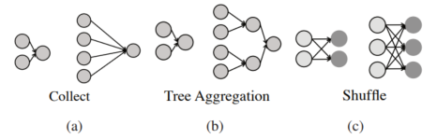
2. Background
Venkataraman, Shivaram, et al. "Ernest: Efficient Performance Prediction for {Large-Scale} Advanced Analytics." 13th USENIX Symposium on Networked Systems Design and Implementation (NSDI 16). 2016.
Performance Prediction
The main steps in building a predictive model
Determining the data points to collect = determining what features should be derived from the training data
Performing feature selection to pick the simplest model that best fits the data
Workload trends
Communication patterns
Numerically Intensive
Sensitive to the number of cores and bandwidth available
Long running → expensive to run on large datasets
All-to-one(collect)
Tree aggregation
Shuffle : many to many
Speech recognition pipeline
Notes:
The main steps in building a predictive model are determining the data points to collect; determining what features should be derived from the training data;
and performing feature selection to pick the simplest model that best fits the data
In this paper, we look at how to perform efﬁcient performance prediction for large scale advanced analytics.
Next, we look at workload trends in large scale data analysis and how we can exploit workload characteristics for performance prediction.
As an example of an advanced analytics job, right figure shows a machine learning pipline used for Speech recognition on TIMIT dataset. (The pipeline trains a model using kernel SVMs and the execution DAG)
This pipeline contains 3 main stages; read input data, normalize data, and build a model.
The model is then refined by generating more features and these steps are repeated for 100 iterations to achieve state-of-the-art accuracy.
Advanced analytics workloads are numerically intensive and hense are sensitive to the number of cores and bandwidth available, they are also expensive to run on large datasets.
The authors note that only a few communication patterns repeatedly occur in analytics jobs.
(a) the all-to-one or collect pattern in which data from all partitions is sent to one machine (b) the tree aggregration pattern where data is aggregated using a tree-like structure (c) the shuffle pattern where data goes from many source machines to many destinations
And for recent hardware and workload trends for large scale data analysis,
Instance types vary not only in capacity (i.e. memory size, number of cores etc.) but also in performance.
For example, we measured memory bandwidth and network bandwidth across a number of instance types on Amazon EC2.
From Figure 1 we can see that the smaller instances i.e. large or xlarge have the highest memory bandwidth available per core while Figure 2 shows that 8xlarge instances have the highest network bandwidth available per core.
The non-linear relationship between price vs. performance is not only reflected in micro-benchmarks but can also have a significant effect on end-to-end performance.
For example, we use two machine learning kernels: (a) A least squares solver used in convex optimization [37] and (b) a matrix multiply operation [75], and measure their performance for similar capacity configurations across a number of instance types.
The results (Figure 3(a)) show that picking the right instance type can improve performance by up to 1.9x at the same cost for the least squares solver.

Slide 4
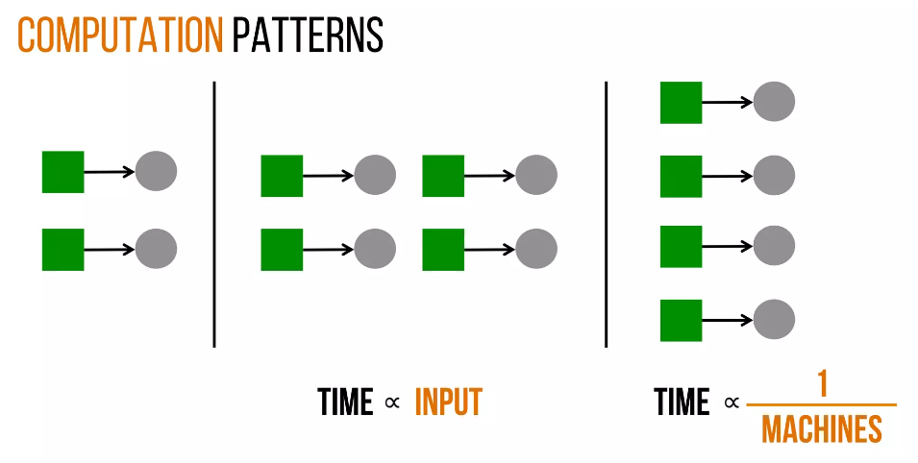
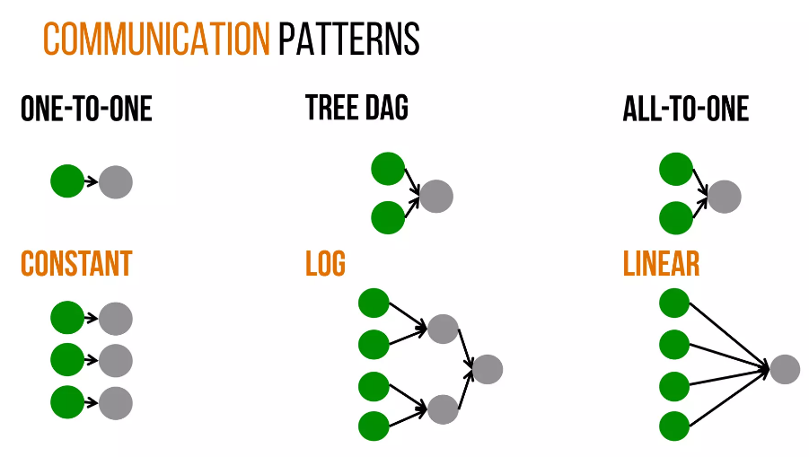
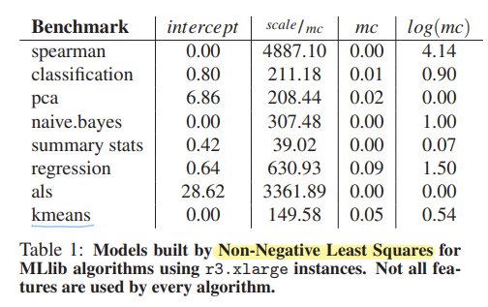
3. Modeling Advanced Analytics Jobs
Venkataraman, Shivaram, et al. "Ernest: Efficient Performance Prediction for {Large-Scale} Advanced Analytics." 13th USENIX Symposium on Networked Systems Design and Implementation (NSDI 16). 2016.
Total time
Computation
Communication
Computation patterns
Communication patterns
Basic model
$$time\text{=}θ_{0}+θ_{1}×(scale×\frac{1}{machines}\text{)+}θ_{2}×\log\left(machines\right)+θ_{3}×machines$$
NNLS
Serial Execution
Computation (linear)
Tree DAG
All-to-One DAG
Collect training data
Fit linear regression
Notes:
Next is about design of the performance model.
The model is built using terms related to these computation and communication patterns
In computation patterns, as seen, when you double the numer of tasks, the time proportionally grows linearly as the size of input grows.
On the other hand, when you increase the number of cores(machines), the time will inversely come down.
The communication patterns are same as discussed before,
So Putting this all together, they form a simple high level performance model for such jobs, as the sum of number of terms.
The model has four components:
θ₀ – a fixed cost term representing the amount of time spent in serial execution
θ₁ x (scale/machines) – And θ₁ times the time spent in computation - to capture the parallel computation time for algorithms whose computation scales linearly with the data
θ₂ x log(machines) – to model communication patterns like aggregation trees
θ₃ x machines - to capture the all-to-one communication pattern and fixed overheads like scheduling / serializing tasks.
The goal is to find the values of θ₀..θ₃ that best fit the training data
Then one thing you might say is is this model good enough and cover all spark jobs,
So they used non-negative least squares (NNLS) solver to find the model that best fits the training data.
From the table we can see two main characteristics: (a) that not all features are used by every algorithm and (b) that the contribution of each term differs for each algorithm
Now such a model formulation is defined, the next step is to collect some training data and then we can use some off-the-shelf libraries in order to fit the model that they are going to use for the system

Slide 5
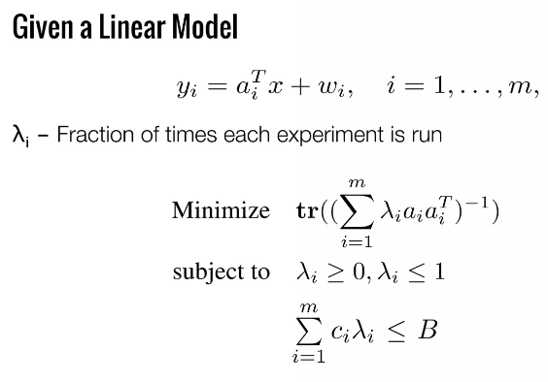
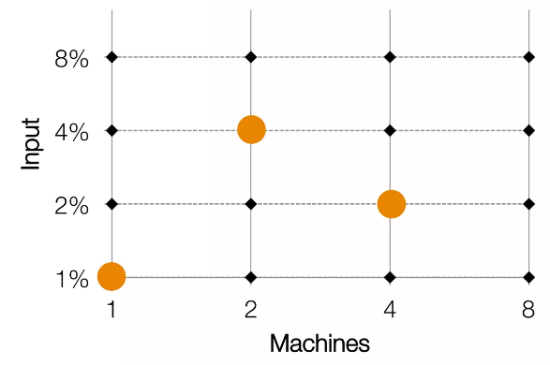
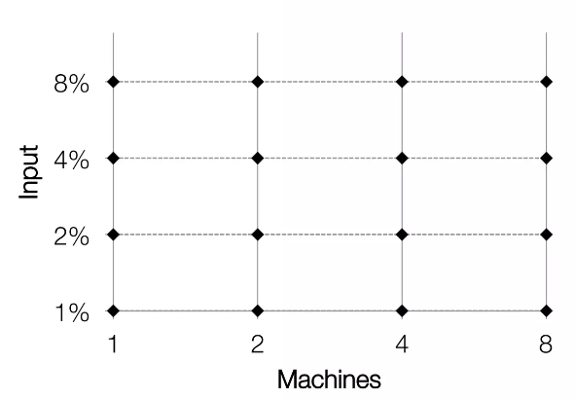
Venkataraman, Shivaram, et al. "Ernest: Efficient Performance Prediction for {Large-Scale} Advanced Analytics." 13th USENIX Symposium on Networked Systems Design and Implementation (NSDI 16). 2016.
3. Modeling Advanced Analytics Jobs
Data Collection
Optimal Experiment Design
Minimizing the time spent on collecting training data while achieving good enough accuracy
2 variables : input, machines
Form a Grid of input, machines
Associate cost with each experiments
Baseline : Greedy approach = Cheapest configurations first ⇒ not good
Notes:
One of the main challenges in predictive modeling is minimizing the time spent on collecting training data while achieving good enough accuracy
If you look at the model, there are 2 variables which is input size and number of machines
So a naïve approach would be forming a grid of these 2 variables, and collect all the values at all the points in the grid
So a slightly better approach is a Greedy approach : only pick the cheapest configurations and collect training data from that -> but they found that it was not that good, and the model was inaccurate
To do some better, they get back to Statistics – use the

Slide 6
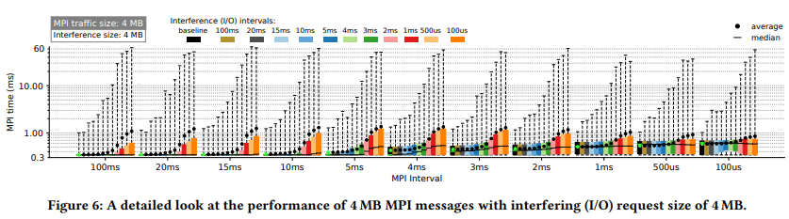
3. Characterization of interference
Brown, Kevin A., et al. "Interference between I/O and MPI traffic on fat-tree networks." Proceedings of the 47th International Conference on Parallel Processing. 2018.
MPI job
4 MB
1.34ms
0.85ms
Reducing the MPI interval improves the MPI performance during high-intensity interference.
All MPI intervals larger than 4 ms experience a maximum slowdown above 300% of the baseline times when the I/O interval is 100 µs.
Summarize
Small interfering requests/messages (4 KB of MPI or I/O) have minimal impact on MPI or I/O performance.
For I/O performance, the impact of interference is moderate if the I/O interval is larger than the I/O-congestion threshold. Below the threshold, interference has negligible effect.
For MPI performance, interference causes variations even when there is a moderate amount of interfering I/O traffic. The most significant impact is observed when the I/O traffic has passed its I/O-congestion threshold.
Overall, the impact of interference is higher for MPI than I/O.
Notes:
To get a more detailed view of MPI performance characteristics, we study the scenario in which 4 MB MPI messages are transferred alongside 4 MB I/O requests in Figure 6.
As described in the previous paragraph, reducing the MPI interval improves the MPI performance during high-intensity interference.
When the I/O interference interval is 100 µs, the average message time for 4 ms MPI interval is 1.34 ms while the average message time for 100 µs MPI interval is 0.85 ms. All MPI intervals larger than 4 ms experience a maximum slowdown above 300% of the baseline times when the I/O interval is 100 µs.
Overall, the results so far can be summarized as follows:
• Small interfering requests/messages (4 KB of MPI or I/O) have minimal impact on MPI or I/O performance.
• For I/O performance, the impact of interference is moderate if the I/O interval is larger than the I/O-congestion threshold. Below the threshold, interference has negligible effect.
• For MPI performance, interference causes variations even when there is a moderate amount of interfering I/O traffic. The most significant impact is observed when the I/O traffic has passed its I/O-congestion threshold.
• Overall, the impact of interference is higher for MPI than I/O

Slide 7
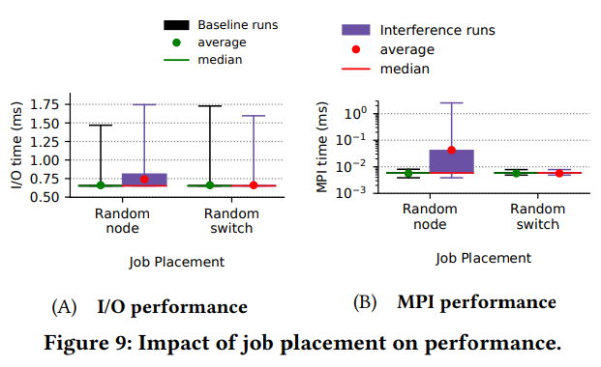
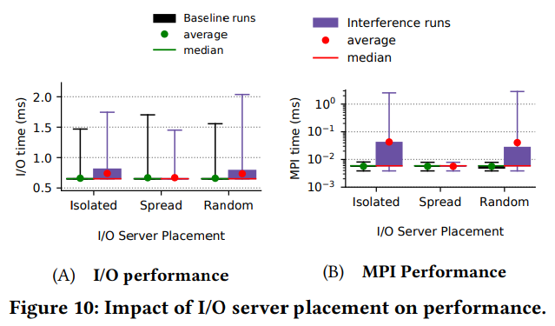
4. Mitigation strategies
Brown, Kevin A., et al. "Interference between I/O and MPI traffic on fat-tree networks." Proceedings of the 47th International Conference on Parallel Processing. 2018.
Job Placement
I/O server Placement
Increase(11.8%)
Increase
(800%)
similar
similar
Random switch :
Improvements - All links connected to switches with I/O servers and clients carry only I/O traffic
Therefore, MPI-I/O interference on links between level1 and level-2 switches is avoided.
The spread-target placement of I/O nodes is best at mitigating interference for both types of jobs
The I/O traffic is confined to a subset of the network and thus does not interfere with the MPI traffic
Notes:
So far, I have presented results on the impact of I/O-MPI interference on the performance of MPI and I/O jobs.
Next, they explore techniques that can potentially mitigate the effect of such interference for the most impacted scenarios.
In particular, we explore three interference mitigation strategies: (i) modifying the placement of jobs to nodes, (ii) relocating the I/O servers, and (iii) throttling I/O traffic.
Figure 9A and Figure 9B show I/O and MPI performance, respectively, for executions with and without I/O-MPI interference for the Random-node and Random-switch job placement schemes.
With the Random-switch placement, we see that the I/O and MPI times for the baseline and interference runs are similar, indicating that there is minimal slowdown due to interference for this type of mapping.
In contrast, for the Random node placement, the average I/O request time increases by 11.8% and the standard deviation increases from 8% to 19% when I/O-MPI interference is present.
And MPI messages experience an average slowdown of 800% with the Random-node placement, and the maximum message time increases by two orders of magnitude
The Random-switch scheme leads to performance improvements because all links connected to switches with I/O servers and clients carry only I/O traffic;
Therefore, MPI-I/O interference on links between level1 and level-2 switches is avoided.
Figure 10 shows the impact of MPII/O interference on performance when the I/O server placement is varied.
They find that the spread-target placement of I/O nodes is best at mitigating interference for both types of jobs. Further, the isolated-target and random-target server placements result in similar slowdown for both jobs.
As a result, the I/O traffic is confined to a subset of the network and thus does not interfere with the MPI traffic.
This insight can guide the placement of LNET routers and burst buffers to leverage the I/O traffic isolation due to the routing algorithm

Slide 8
Thank You ☺

